Slide 1
JSON: Editing tool
VBA + Python Integrated Tool
Authored By | Nameera .

Slide 2

What is a json?
Java Script Object Notation syntax. JSON is a lightweight data interchange format commonly used for transmitting data between a server and a web application.
These key-value pairs are separated by a colon(:), and different pairs are separated by commas.
These different pairs /objects are encapsulated within curly braces({ }).
Within each object, keys should be unique.
Values can be single or there could be an array of values. Array in JSON can be stored in square brackets ([ ]).
The value in a JSON can be of datatype: a string, a number, an object (JSON object), an array, a Boolean, null.

Slide 3
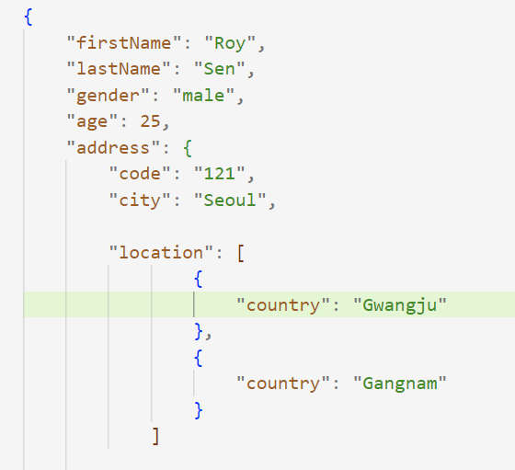
JSON structure and Syntax
A JSON object is a key-value data format that is typically rendered in curly braces.
Most data used in JSON ends up being encapsulated in a JSON object.
IN JSON, data Stored as key-value pair. Here for ex-
‘firstName', 'lastName’ , ‘gender’ are the keys and Roy’, Sen’, ‘male’ are their values respectively.
Within each object, keys need to be unique.
A JSON Path expression specifies a path to an element (or a set of elements) in a JSON structure. Paths can use the dot notation. Ex: address.location.[0].country , address.location.[1].country
JSON paths are required in order to query the data or traverse through the data in a JSON file.

Slide 4
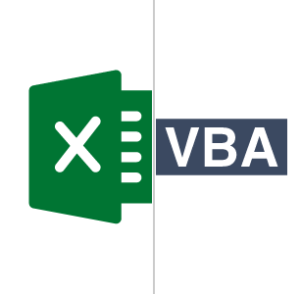
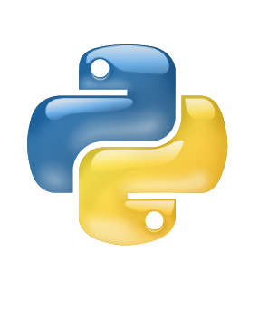


Automate editing of multiple json attributes
Authored By | Nameera .

Slide 5


Manual vs automated editing
V/S

Slide 6
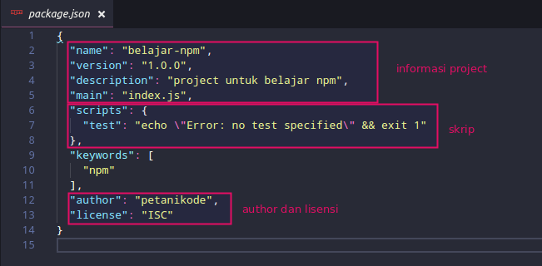
Manual process of json editing
Time-Consuming Process: If we want to edit/update multiple attributes inside a JSON or need to edit multiple JSONs, then this process will be time consuming- to open each JSON, edit and then save.
Poor JSON Formatting: The structure and beautification of JSON files will disturb if we are making updates or adding attributes in a JSON without following proper syntax and structure of a
JSON.
Need to understand complex structure of JSON : If we are manually editing any JSON must make sure that syntax or structure is intact and not disturbed after editing.
Automated process of json editing
Saves time
Can edit multiple JSON at a time
Keeps JSON syntax correct, with proper indentation
Authored By | Nameera .

Slide 7



JSON EDITING TOOL

Slide 8
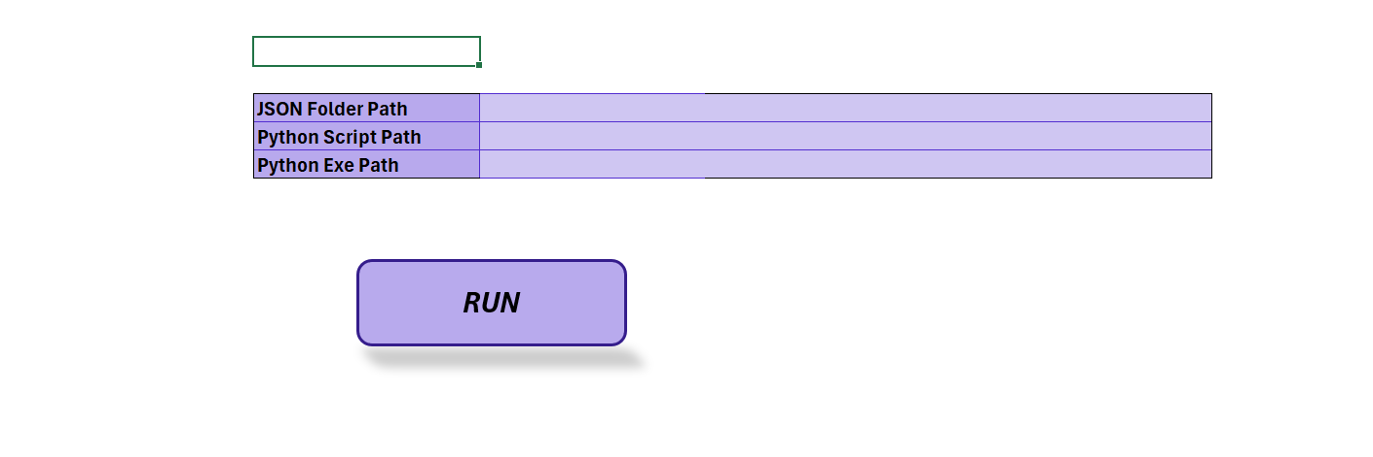
User Interface of the JSON editing tool– Home Tab
Folder path where JSONs are placed
python code path
Run Button
Python Exe path

Slide 9
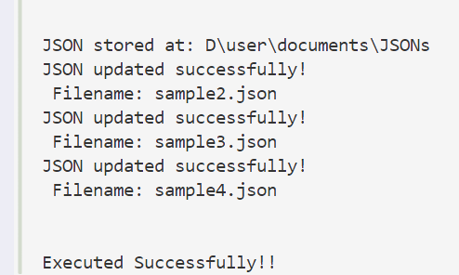
User Interface of the JSON Editing tool
Authored By | Nameera .

Slide 10
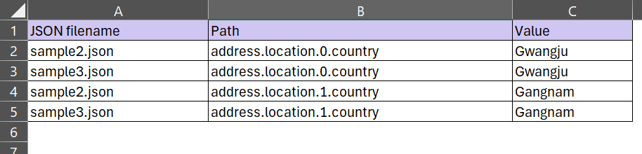
attribute tab for JSON editing
Give your JSONs file name here
Path for your attribute/Key
Required value for your path/Key

Slide 11


Pre-requisites and preparation
Installation of Python and required libraries, that enables the python code to be ran seamlessly.
Home page should be populated with the proper paths as required for the JSON folder path and python code location and python.exe location of the system. This is required for the VBA to call the python code during the time of execution. Any mistakes in these two will bounce back and error .
Proper JSON file name. The name of the files should be proper and matching with the one existing at provided folder.
Proper attribute path. The dot notation path of the attribute should be correct and matching if already existing in JSON, and if not then the syntax should be as per your need wherever the attribute needs to be added inside JSON.

Slide 12

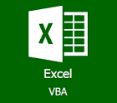

RUN
End user
Data editing requirements
Python code
JSON Files are will be updated with each attributes mentioned in VBA
Process of JSON records editing using the Tool

Slide 13
Key benefits of using the JSON editing tool
While working with JSON files sometimes it becomes difficult to write data due to its nested/complex structure. Using the editing tool the attribute will be added to its correct position with proper syntax and structure of JSON with proper indentation.
No of JSON files | Time Taken to update single attribute in Files | Time Taken to update multiple attribute in Files | Time taken to update using tool
2 to 3 | 5-10 mins | 10-15 mins | 2-3 mins
10 to 15 | 20-50 mins | 40-60 mins | 10-15 mins
One can get quick and accurate results with updated JSON.
The JSON syntax will remain proper
Multiple files can be edited at same time with multiple attributes in a single file.

Slide 14
THANK YOU
Authored By | Nameera .

